Slide 1

TORRY HARRIS BUSINESS SOLUTIONS

Slide 2

ECOMMERCE WEBSITE
A USER FRIENDLY SMART PHONE SHOPPING WEBSITE
TEAM
ABHAY PD KALWAR SHARANYA SHETTY PRAJWAL SR SANJANA KRISHNA
BATCH -87

Slide 3
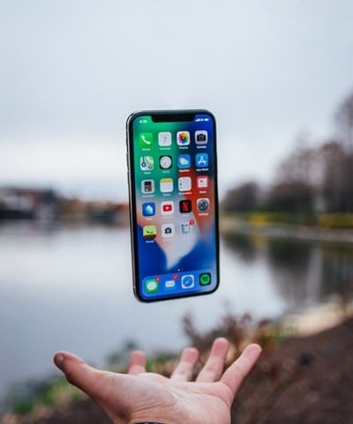
CONTENTS
Introduction Problem
Statement Design
Functional Requirements
Screenshots

Slide 4
INTRODUCTION
Internet has become an important medium for doing global business based on the state of the art technology. The availability of Internet has led to the development of E-Commerce (Electronic commerce), in which business transactions take place via telecommunication networks.

Slide 5
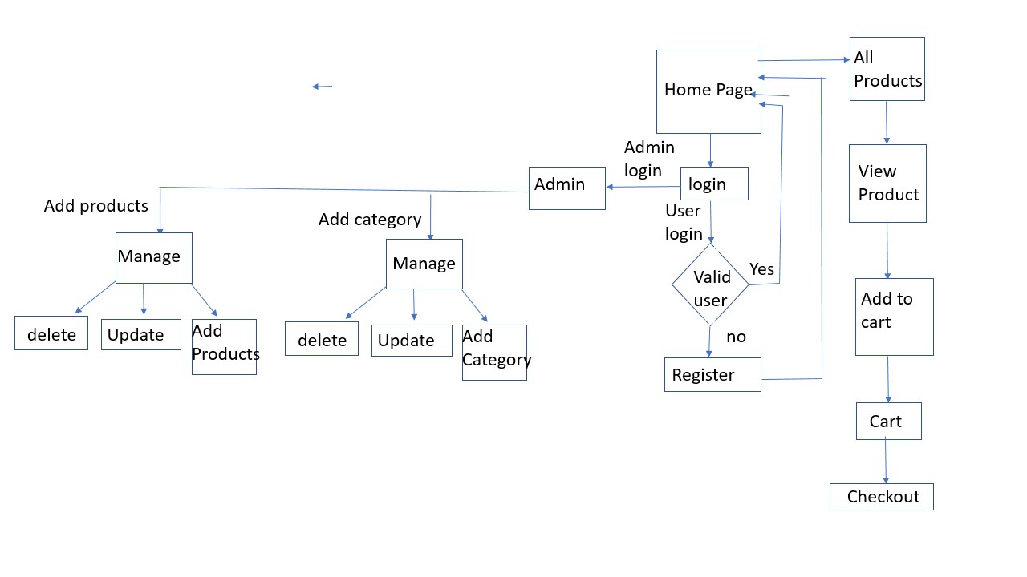
SYSTEM DESING

Slide 6
Functional Requirements:
Admin :
Only Admin can add New product and it’s Category
Admin Can View the all the Activities on website
When Admin Add the new Products the Products should display on the Screen.
When Admin makes any changes on the website it should be displayed on the screen.
User :
First user should Register in the website.
User can also login using google account.
The user can log in to the system by using his specific email and password.
User should view the products on website.

Slide 7
Technology Used in Project
Spring boot MVC
Bootstrap
HTML5
CSS3
H2-Database

Slide 8
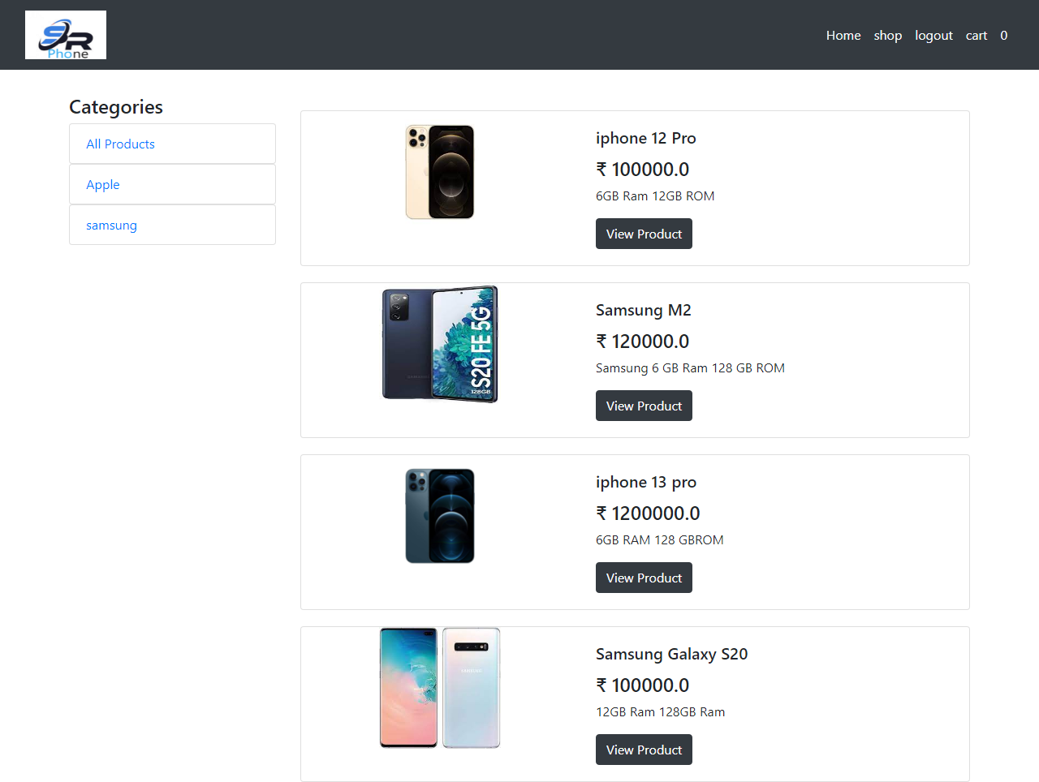
Screenshots
Home Page

Slide 9
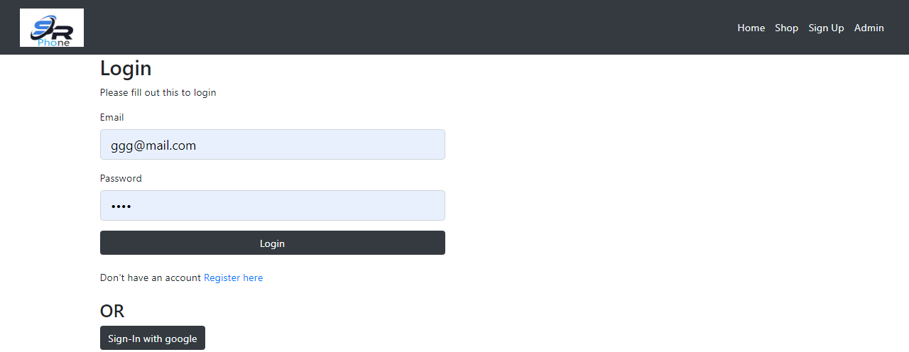
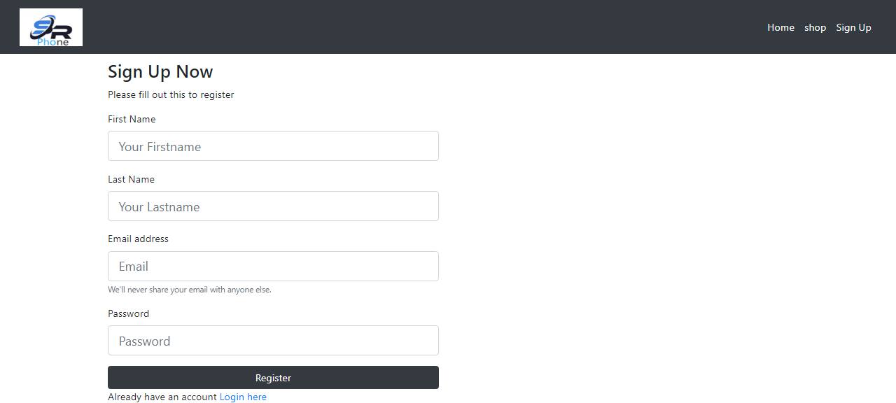
Login and Sign UP Page

Slide 10
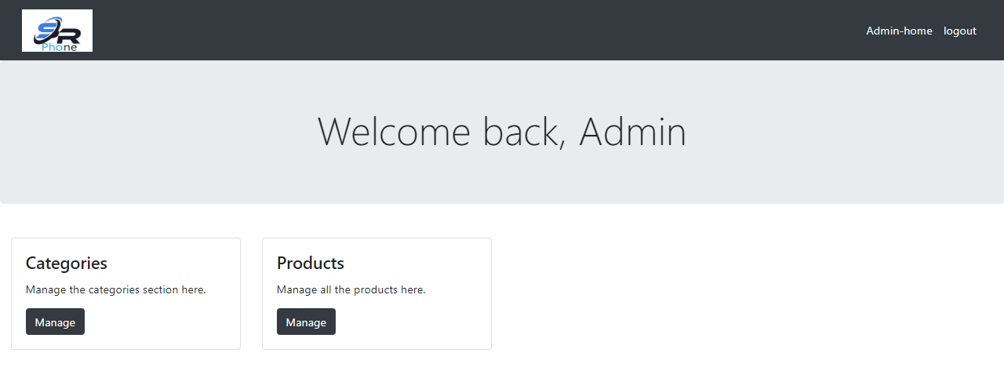
Admin Page

Slide 11
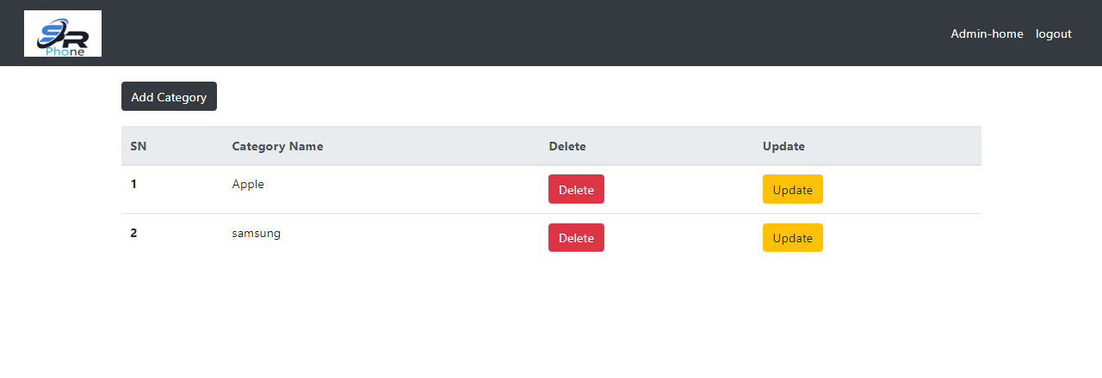
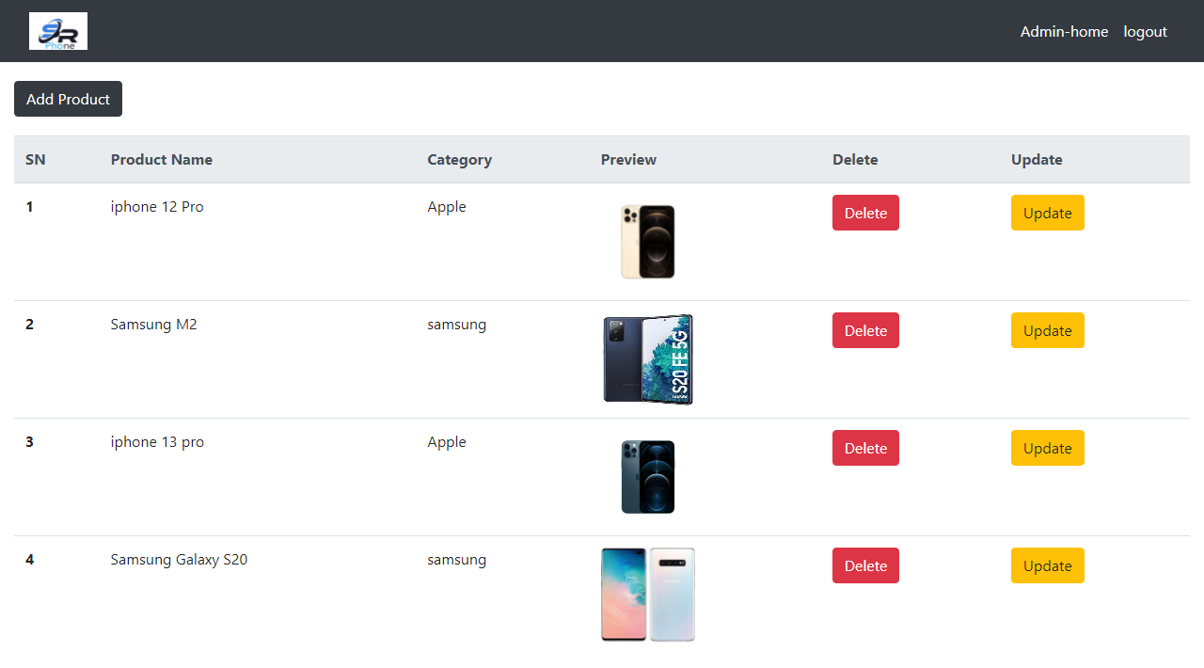
Category and Product Page

Slide 12
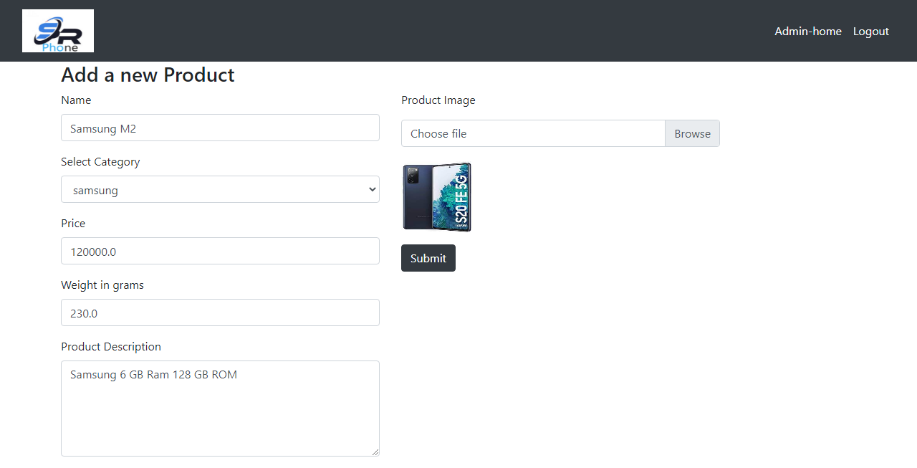
Add Product Page

Slide 13
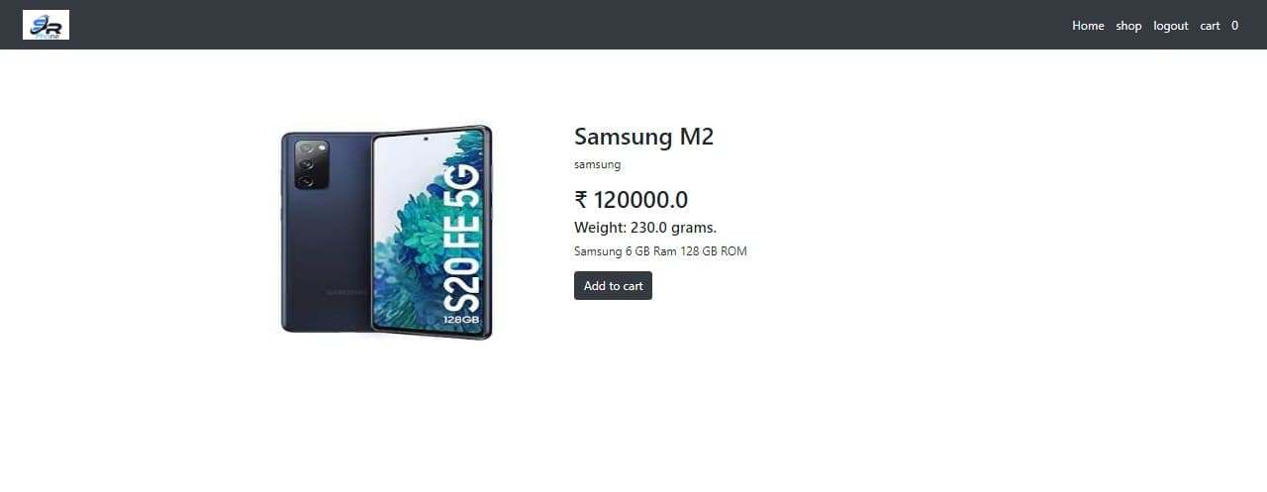
View Product Page

Slide 14
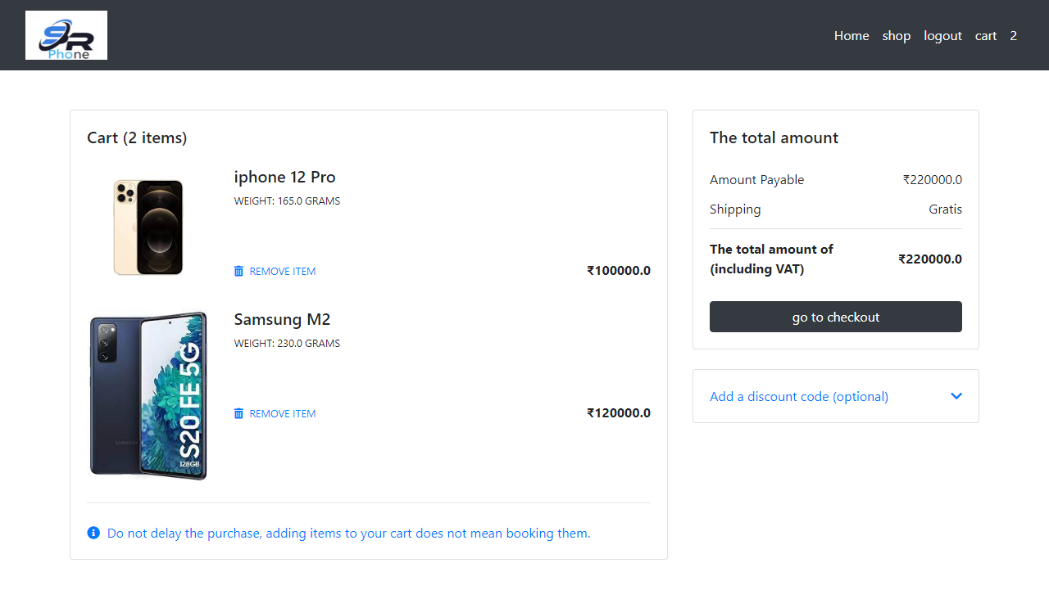
Cart Page

Slide 15
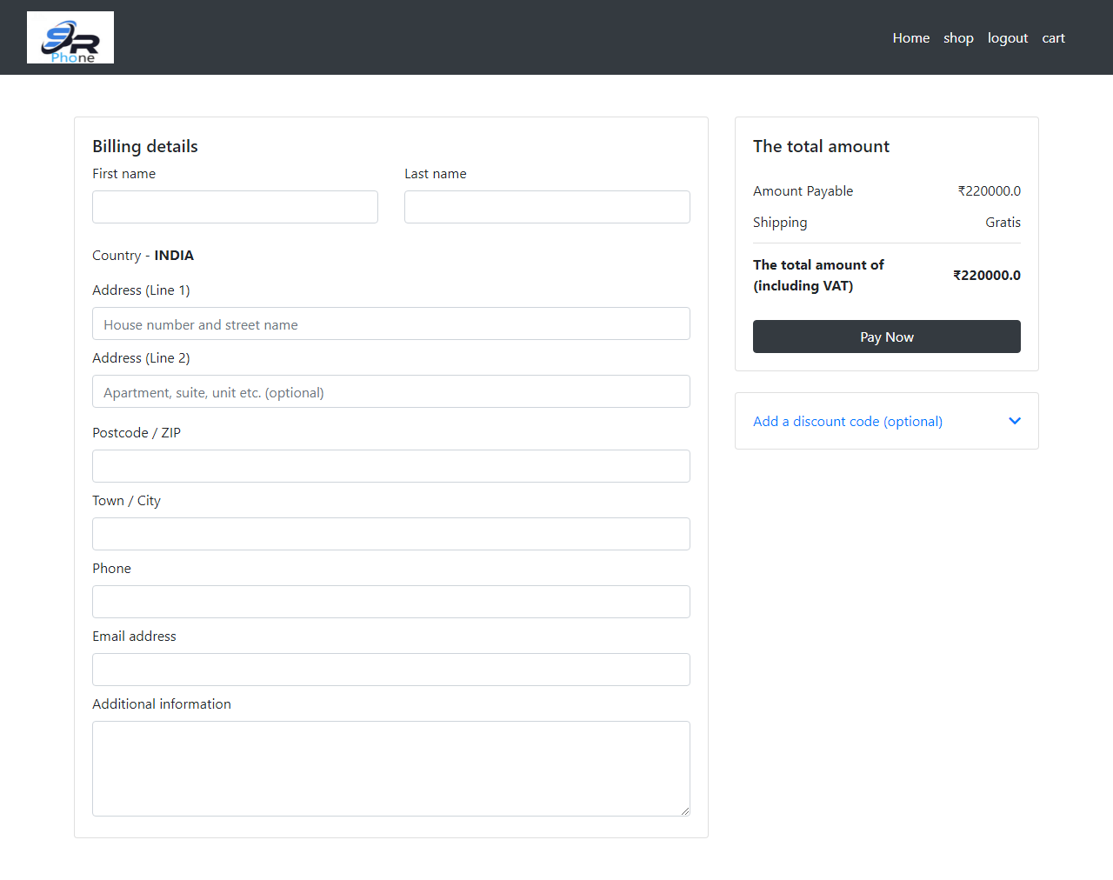
Billing Page

Slide 16
Thank You

